Slide 1

Security issues in the Organization: An Ethical Perspective in Bangladesh
Presented by:
Atiq Ahammed BSSE0817
Md. Hasan Tarek BSSE0818
S.M. Khayrul Islam BSSE0822
Presented To:
Rezvi Shahariar

Slide 2
Introduction

Slide 3
Ethics
Laws
Information Security
Policies
Security Issues
Privacy Issues

Slide 4
Background Studies

Slide 5


Slide 6

Need for Information Security in Organization
Maintain Customers’ Trust
Safeguard Information
Having consistent security practices

Slide 7
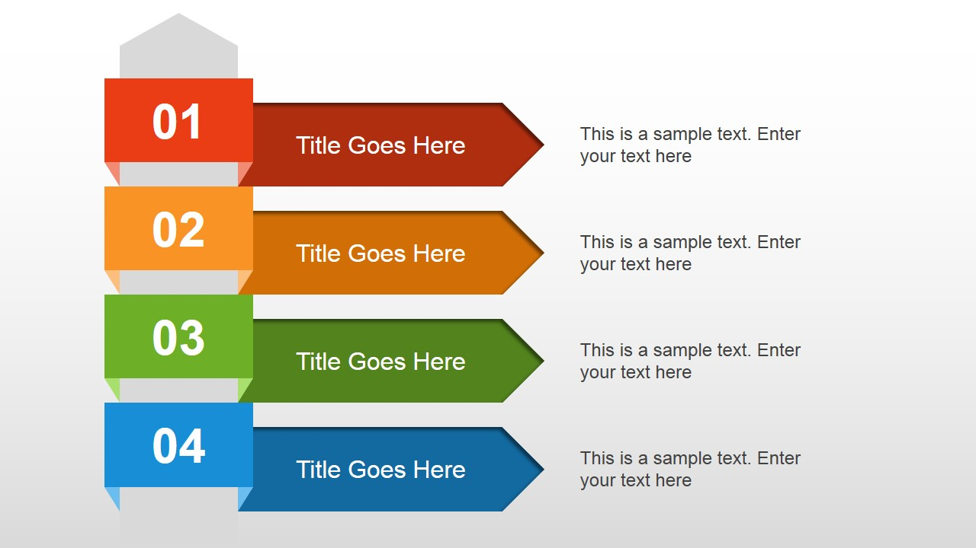
Security Issues in Organizations
Identity theft
the fraudulent practice of using another person's name and personal information in order to obtain credit, loans, etc.
Copyright infringement
is the use of works protected by copyright law without permission, infringing certain exclusive rights granted to the copyright holder.
Click fraud
the practice of repeatedly clicking on an advertisement hosted on a website with the intention of generating revenue for the host website or draining revenue from the advertiser
Advance fee fraud
An email is sent to the target victim that
promises them a lot of money in favor of helping them to claim their inheritance money.

Slide 8
Methodology

Slide 9
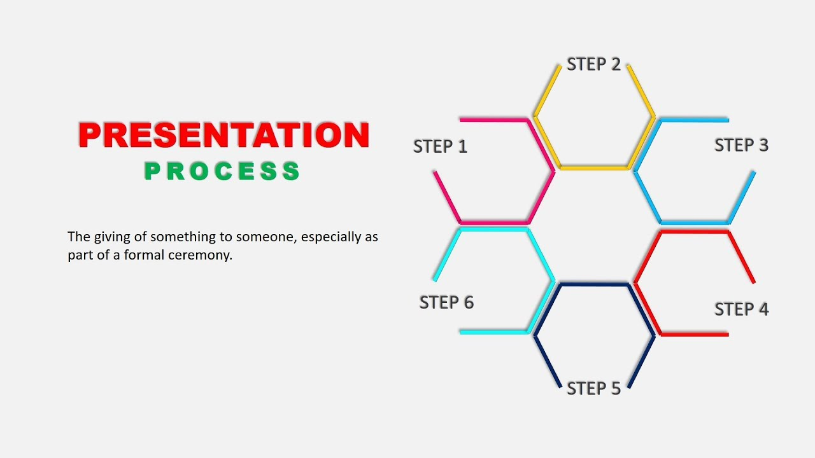
literature review
Research Design
develop the survey proposal
designing the
study questionnaire
FINALLY
conclusion and
recommendations
data analysis and
discussion
distributing the questionnaire to a pilot study
ensuring validity and reliability

Slide 10


Data Collection Resources
Secondary Resources:
books, papers, essays, journals, research
studies and reports
Primary Resources:
employees working at different organization or company in Bangladesh

Slide 11
Survey Findings & Analysis

Slide 12
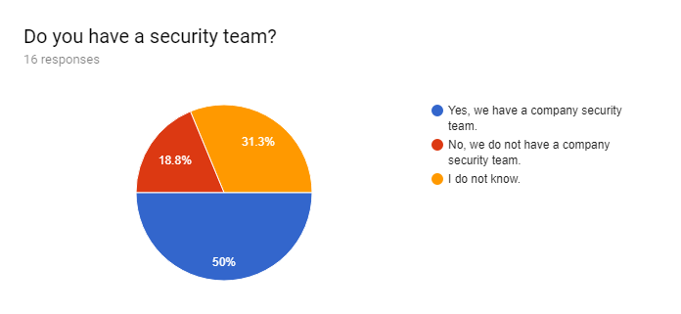

Slide 13
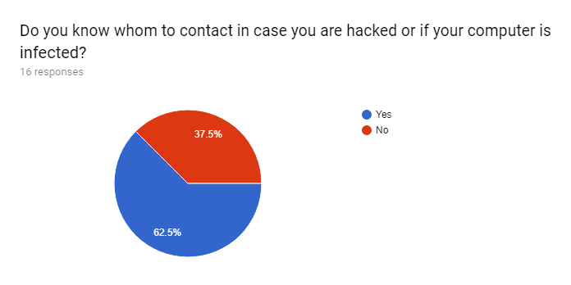

Slide 14
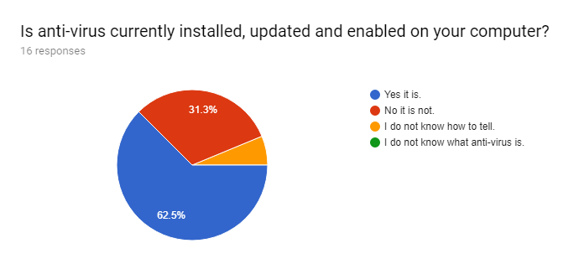

Slide 15
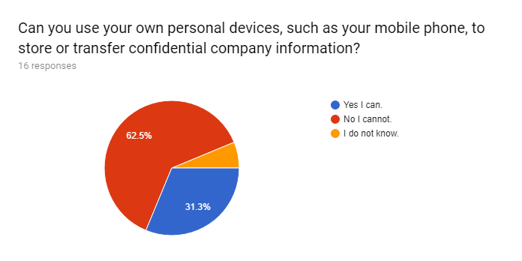

Slide 16
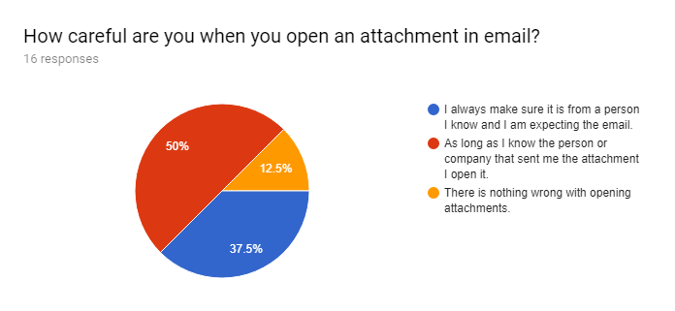

Slide 17
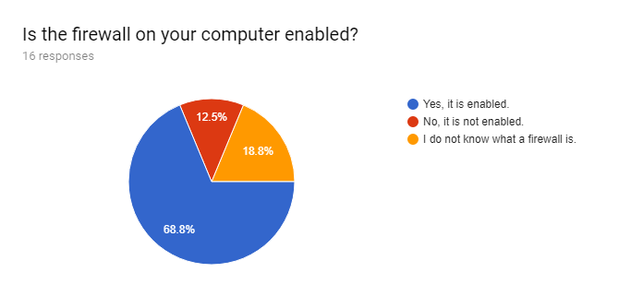

Slide 18


Slide 19
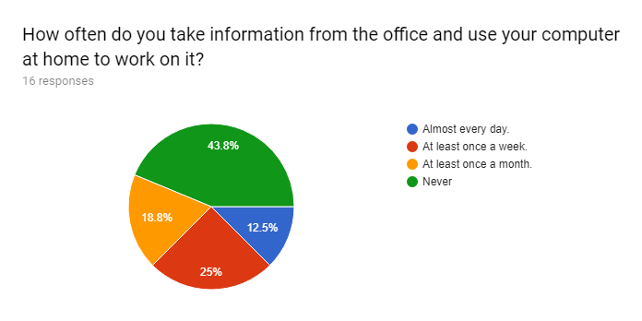

Slide 20
Recommendation

Slide 21
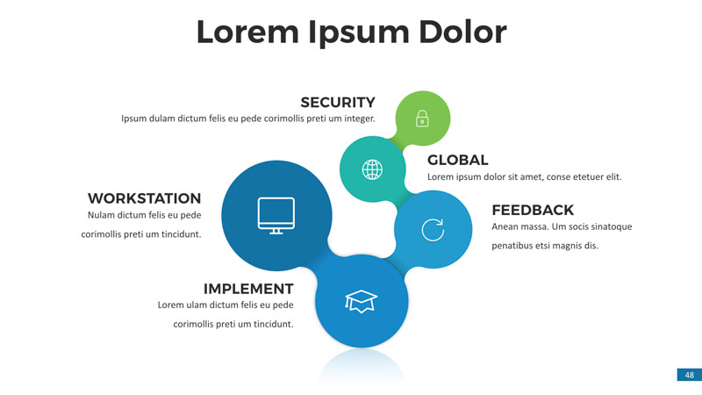
Standard Policies
Being Loyal
Building a Strong Information Security Program
Guideline
Training

Slide 22
Thank You

